Slide 1
Data Project Proposal
Presentation
Team 3: Christopher, Malik, Mohammed & Kelly
16th February 2024

Slide 2
Why should we focus on customer retention?
01
Chapter

Slide 3





Customer Retention: Why it matters
In 2022, Lloyds Banking Group lost more customers than it gained in every quarter of the year.
The ratio of customers gained was negative 1.3 in both the third and second quarters of 2022.
1,001
5x more
However, 2023 saw a slight improvement in 2023 for Q1, gaining 1.3 customers for each that left.
Net customer gain in bank account switchers for 2021
Spent on new customer acquisition compared to customer retention
Most research estimates it costs 5 times more to attract new customers than it is to retain them.
Research suggests that for most businesses, around 65% of their business comes from existing customers.
65%
25m
Neobanks present increased challenges, with more people switching and staying.
Research estimate of existing customer contribution to most profits for most businesses.
Average number of LBG customers 2020-2022

Slide 4

Acquiring new customers is important, but retaining them accelerates profitability.

Slide 5
The Project Proposal
02
Chapter

Slide 6
Predicting customer churn
Through segmentation analysis and machine learning
Aims:
The questions we seek to answer
Can we successfully predict if a customer is likely to leave?
What factors are most influential to a customer deciding to exit?
What keeps people staying?
Identify and create a machine learning model to best predict potential leavers.
To test this model with a fictional sample dataset.
Identify strengths, limitations and areas of improvements to enhance the model.
Show how we intend to move our plans to Google Cloud Platform Technology
Creating better predictive capabilities through harnessing our expansive customer data.

Slide 7
Data Analysis
03
Chapter

Slide 8













Data analysis: key points
CONTEXT
2
1
BANK DEPOSITS LOST FROM LEAVERS
COMPLAINT IMPACT
To help demonstrate this proposal a sample customer churn dataset was obtained from Kaggle. It contained 10,000 entries. The features recorded in the dataset appeared to be a good general baseline to begin exploring analysis to then move to developing predictive machine modelling. However, there are many challenges with the data, and it would benefit from granular detail. Notably absent is any time series data which would give further insight into seasonality and/or how marketing campaigns or significant world events could impact leaver rates.
99.5% of exited customers had registered a complaint.
99.5%
3
GENDER FACTORS
4
FEATURE IMPORTANCE excl. complaints
5
TOP TAKE AWAYS
1
Age
All machine learning models ranked Number of Products, Age and Join Age as the top 3 features important in predicting leavers
50%
Women are at least 50% more likely to leave than men across most demographics.
The findings suggest that those within brackets 50-59 and 40-49 leave at a much higher rate that other age bands.
2
Number of Products
50 - 59
Age group with the highest rate of leavers
Customers holding 1, 3 or 4 products left at a rate of around 25-30% compared to those with 2 products at a rate of around 2%-5%.
Including complaints in the model significantly reduces all other feature importance. Therefore, complaints should be reviewed separately.
3
Join Age
100%
Of customers with 4 products exited the bank. It is worth noting that 100% of them registered a complaint.
There appears to be little variation in the leaving percentage rate considering customer tenure.
6
RECOMMENDED ACTIONS
Focus
Change
Grow
Focus retention efforts on ages 30 to 60.
Further analysis upon data acquisition
Utilise Self-Serve analytics tools to empower workers
Utilise machine learning models to predict leavers
Maximise ROI
Higher Lifetime Value
Stability and Loyalty
Upselling Potential
Current analysis is based on a test sample with limited features.
More granular detail will help identify more significant factors. E.g. do certain products help with retention.
Provide interactive dashboards focused on key churn features to help those with retention responsibilities identify target customers.
Using identified patterns and correlations we can initiate pre-emptive retention activity.
Adopting cloud technology will enable us to further refine our predictive capabilities.
An interactive calculator to predict if a customer is likely leave.

Slide 9
Machine Learning Exploration
04
Chapter

Slide 10
Machine Learning: Process
Split and Balanced Data
Trained Models: Train each ML models (Decision Tree, Random Forest, AdaBoost)
Evaluated Models: The performance of each model
Accuracy: Ratio of correctly predicted observations to the total observations.
Precision: Ratio of correctly predicted positive observations to the total predicted positive observations.
Recall (Sensitivity): Ratio of correctly predicted positive observations to the all observations in actual class.
F1 Score: Harmonic mean of precision and recall.
Confusion Matrix: Provides a breakdown of the predictions and actual class labels.
Compared Results: Performance of each model based on the evaluation metrics. Consider both overall performance and how well the models perform on specific aspects of your problem.
Fine Tune Hyperparameters: Optimize their performance. This can be done using techniques such as grid search or randomized search.
Selected Best Model: Based on the evaluation results, selected the model that performs best according to evaluation criteria. Not necessarily be the model with the highest accuracy, but the one that best meets the requirements of your problem and business objectives.
Our Final Recommendation

Slide 11


Machine Learning Tests
Accuracy
Precision
Recall
Precision
Summary
This model has the lowest accuracy among the three (0.83), meaning it correctly predicts the outcome for 83% of the instances.
It has decent precision (0.62) for class 1, meaning when it predicts an instance as positive, it’s correct around 62% of the time.
However, the recall for class 1 is relatively low (0.46), indicating that it misses around 54% of the actual positive instances.
Decision Tree
Based on these metrics, it appears that AdaBoost performs the best overall among the three models. When considering the F1-score across all models, meaning It achieves a good balance between precision and recall for class 1 (0.59) compared to random forest (0.58). However, if precision for class 1 is of utmost importance, Random Forest might be preferred due to its higher precision.
We would recommend…
1
This model shows the highest accuracy (0.86), implying it correctly predicts outcomes for 86% of the instances.
It achieves a higher precision for class 1 (0.81) compared to the Decision Tree, meaning when it predicts an instance as positive, it's correct around 81% of the time.
However, the recall for class 1 is lower (0.45) compared to the Decision Tree, suggesting it misses more positive instances.
>
Random Forest
2
Though different evaluation metrics are provided compared to the other models, we can interpret it as accuracy, which is approximately 85%.
It has second highest precision (0.72) for class 1, meaning when it predicts an instance as positive, it’s correct around 72% of the time.
Has the highest recall for class 1 (0.5), indicating that it misses around 50% of the actual positive instances.
ADA Boost
3

Slide 12
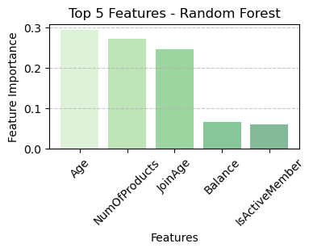
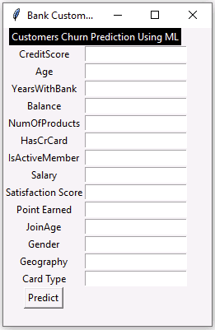
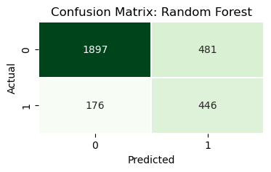
Machine Learning: Best Model
Process
Customer Churn Calculator
Features
Result
Average number of LBG customers 2020-2022

Slide 13
Utilising Google Cloud Technology
05
Chapter

Slide 14

Project benefits from utilising GCP Technologies
The Next Step
Benefits
…creating higher and more sustainable value
Storage and infrastructure can be scaled up or down to meet demand.
By analysing data in real-time and at scale, businesses can make data-driven decisions, identify trends and patterns, optimize operations, and uncover new revenue opportunities.
To fully realise our data and insight capability, moving this project to Google Cloud Platform will be hugely beneficial.
Scalablity
Removes the need to manage complex infrastructure. Allowing the focus on modelling and testing.
Managed Service
Can seamlessly integrate services in one place for an optimised end-to-end solution.
Integration

Slide 15
Architecture, Infrastructure & Skills
Big Query
Vertex AI
Skills
Large-scale data analysis
Ad-hoc querying
Real-time analytics
Data warehousing
Great for Structured data
No code environment
Scalable deployment
Automated workflows
Suitable for varying technical ability
Essential skills: basic data and programming skills.
Desired skills SQL proficiency, machine learning concepts, Python programming, statistics, data visualization, and cloud platform experience.
A fully managed, serverless data warehouse solution on Google Cloud Platform for storing, querying, and analysing data.
A unified platform on Google Cloud for building, deploying, and managing machine learning models at scale
Data Storage
Model Training
Model Evaluation
Deployment
Big Query
Vertex AI
Big Query & Vertex AI
Vertex AI
1
Performance
High speed querying
Rapid Data Retrieval
1
AutoML Capability
Suite of tools requiring minimal effort
Good for varying degrees of technical ability
1
AutoML Evaluation
Automated visuals and dashboards
1
Model Versioning and Monitoring
Track different versions
2
Model Monitoring and Management
Alerts for anomalies and performance degradation
Custom evaluation metrics
2
Integration: AI Platform Prediction
Managed service to deploy model at scale
Handles full model serving
2
Cost-Effective
Pay-as-you-go pricing
2
Hyperparameter Tuning
Automatic model optimisation

Slide 16
Thank You

